Slide 1

Understanding variability in response to therapy across patients with colorectal cancer metastasizing to liver
Adam Wojtulewski
Moffitt Cancer Center
Machine Learning Department
Karolak Lab

Slide 2
About me
Year, major, university, other info, photo
LinkedIn QR code/link ->
Karolak Lab QR code
Internship opportunity to have a hands-on application of machine learning approaches

Slide 3
Understanding Key Terms
Metastasis (MS) - the spread of cancer cells from the place where they first formed to another part of the body
Ex. If a patient with colorectal cancer also has liver MS, this means that colorectal cancer cells have spread to the patient’s liver
Metachronous MS - MS that develops after completion of the initial curative treatment
Synchronous MS – MS that develops together with or within a three-month interval of the diagnosis of the primary cancer
Resection – the process of cutting out tissue or part of an organ.
Aneuploidy - an abnormality in the number of chromosomes in a cell due to loss or duplication

Slide 4
Understanding Colorectal Cancer
Colorectal cancer (CRC) is the second leading cause of cancer related mortality in men and women combined
Patients with metastatic CRC (mCRC) have an extremely poor survival rate of as low as 14% at 5-years
Of which, liver metastases account for a large portion of the deaths
Effective chemotherapy agents and novel systemic therapies improve these numbers
However, patients with similar mCRC features still respond differently to treatment

Slide 5
Reasons for Varied Responses to Treatments
Patients with similar demographic characteristics and even similar cancer features, such as site of primary metastasis, may have different responses to treatments

Slide 6
What has already been researched
High inter-metastatic heterogeneity was a key determinant of poor patient outcome after partial liver resection
a level of genomic complexity below 25% was associated with a favorable patient outcome also in metastatic CRC
However, there is not much information out there about how best to treat patients with higher genomic heterogeneity

Slide 7
What needs to be researched
There are several molecular subtypes (MSS, MSI, POLE) – which one has the highest heterogeneity (variation) in response? Do other features play a role, such as demographic information or different types of drugs being used?
Given the drugs that patients were given, how long will they survive?
Based on the vital statuses of past patients, which drugs are best suited for certain patients?
Are there subgroups that are good responders? What can we see is different about them?

Slide 8
Materials and methods
Datasets
Data Pre-processing
Data visualization
K-Means Clustering
Random Forest Classifier
Artificial Neural Networks (Deep Learning)
Model verification

Slide 9
Datasets

Slide 10
Data Pre-processing

Slide 11
Data visualization

Slide 12
K-Means Clustering

Slide 13
Random Forest Classifier

Slide 14
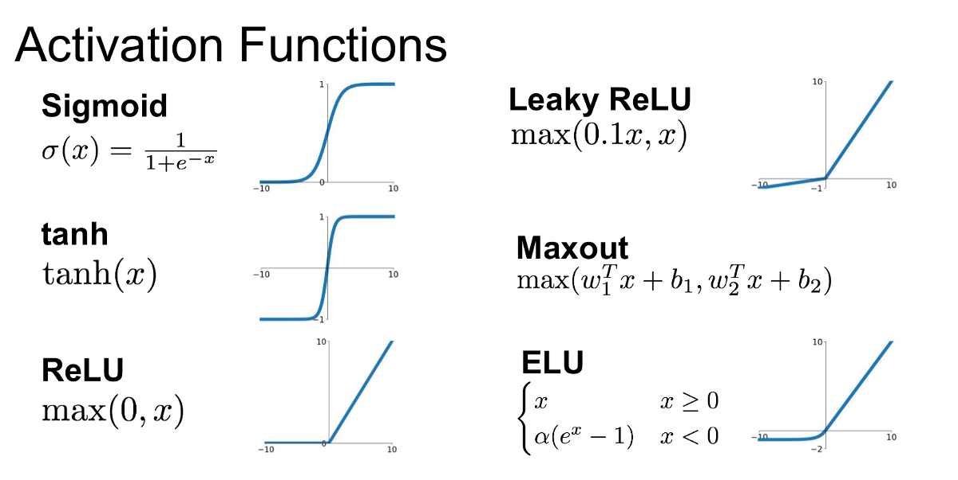
How Neural Networks Work

Slide 15
Artificial Neural Networks (Deep Learning)

Slide 16
Model verification

Slide 18
Future directions
Transfer learning to Moffitt Data
Development of a self-learning interface to support clinical decision making

Slide 19
Acknowledgements
Family, Machine Learning, team members

Slide 20
Thank you
Question

Slide 21
Sources Consulted
https://www.cancer.gov/publications/dictionaries/cancer-terms/def/metastasis
https://bjssjournals.onlinelibrary.wiley.com/doi/10.1002/bjs5.50341#:~:text=Metachronous%20metastasis%20was%20defined%20as,mm%20of%20the%20resection%20margin.
https://www.ncbi.nlm.nih.gov/pmc/articles/PMC3349572/#:~:text=%22Synchronous%20metastasis%22%20and%20%22synchronous,of%20the%20primary%20colon%20cancer.

